Slide 1

Introduction to Cryptography

Slide 2

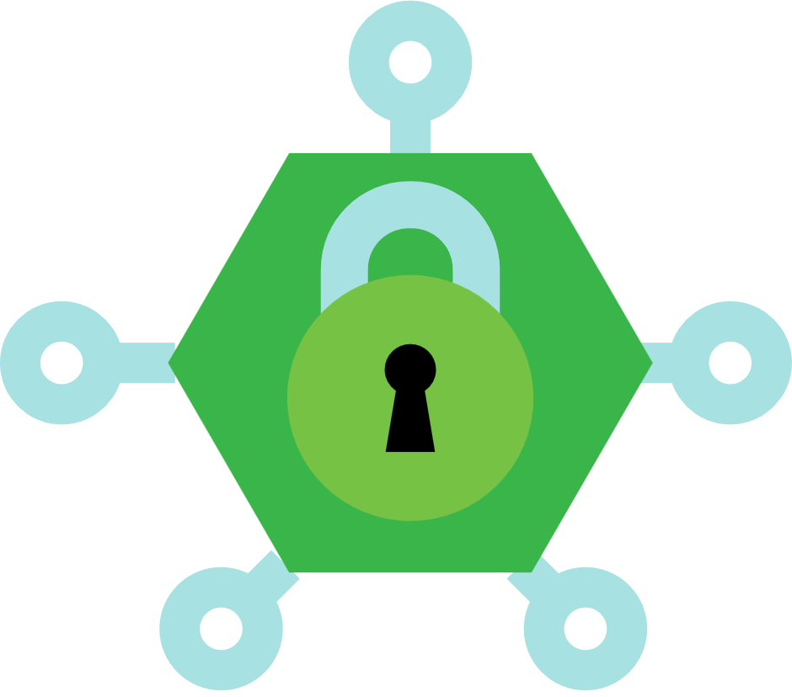



SOMETHING ABOUT ME
I’m Hafiz Muhammad Attaullah
PhD (MMU Malaysia), MS (NED UET), Executive Education (Stanford), BS (CYS)
xCyber Security Consultant at GreensFin (Meezan Bank’s FinTech)
Lecturer (CYS) & FYP Head at Mohammad Ali Jinnah University
InfoSec Product Builder, NANOTECHX (Microsoft Imagine Cup Winner)
Secretary, IEEE Computer Society, Karachi Chapter
Community Manager, Cisco Community Pakistan
Cisco & Microsoft Certified Official Trainer
OSCP Certified
5x Microsoft Certified and MVP
2x Cisco Certified
2x IBM Certified
2x Aviatrix Certified (Multi-cloud)
attaullah@nanotechx.org
https://attaullah.com.pk/
@HafizMuhammadAttaullah

Slide 3
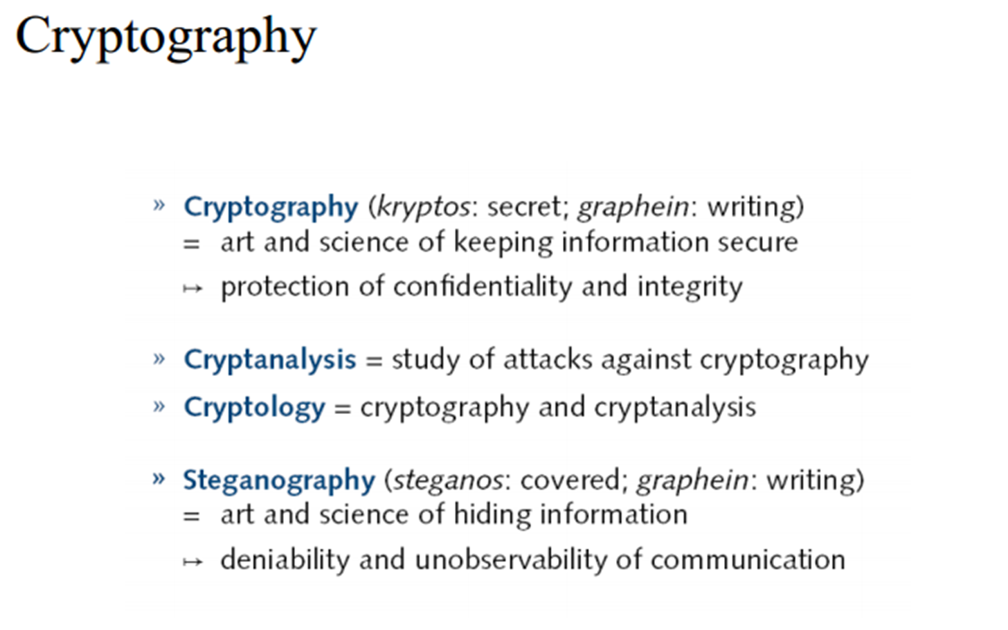

Slide 4
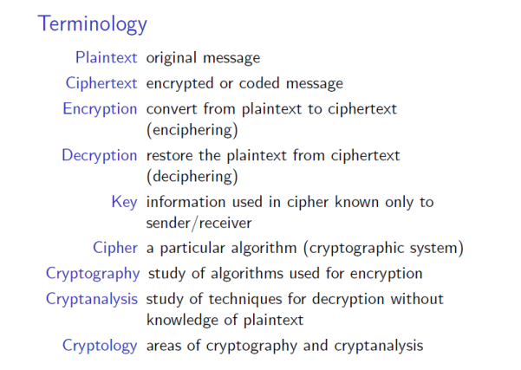

Slide 5
Definition
Encryption normally works in the following way:
A message in its original form (plaintext) is encrypted into an unintelligible form (ciphertext) by a set of procedures known as an encryption algorithm and a variable, called a key; and the ciphertext is transformed (decrypted) back into plaintext using the encryption algorithm and a key.

Slide 6
Definitions - Crypto-speak
Cryptography is the study of secret (crypto-) writing (-graphy)
Cryptography deals with all aspects of secure messaging, authentication, digital signatures, electronic money, and other applications
The practitioner of Cryptography is called Cryptographer

Slide 7
Why Cryptography?
Concerned with developing algorithms which may be used to:
Conceal the context of some message from all except the sender and recipient (privacy or secrecy)
Verify the correctness of a message to the recipient (authentication)
Form the basis of many technological solutions to computer and communications security problems

Slide 8
Definitions
In cryptographic terminology, the message is called plaintext or cleartext.
Encoding the contents of the message in such a way that hides its contents from outsiders is called encryption.
A method of encryption and decryption is called a cipher - The name cipher originates from the Hebrew word "Saphar," meaning "to number.”
The encrypted message is called the ciphertext.
The process of retrieving the plaintext from the ciphertext is called decryption.
Encryption and decryption usually make use of a key, and the coding method is such that decryption can be performed only by knowing the proper key.

Slide 9
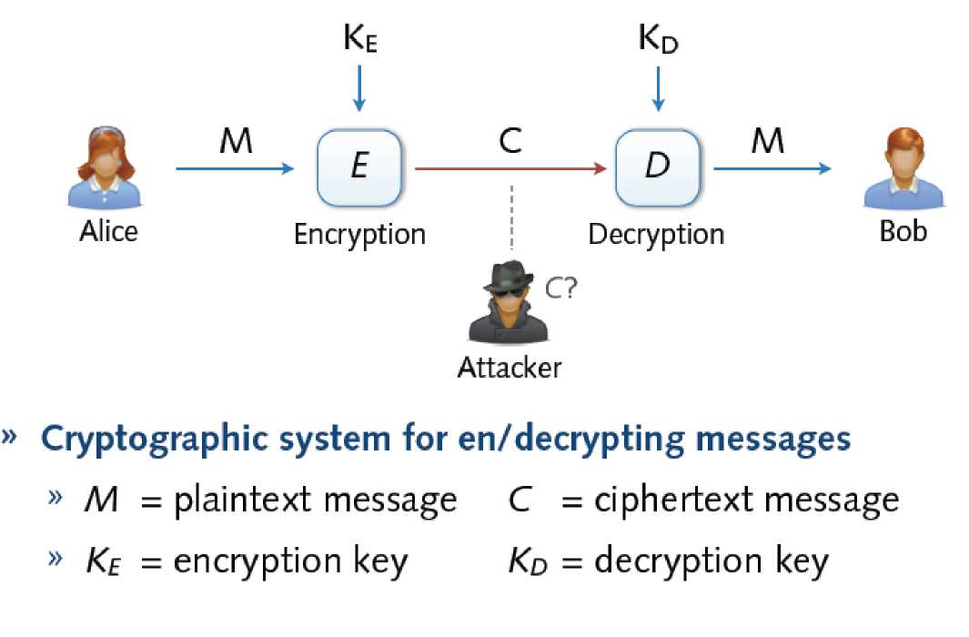
Cryptosystem

Slide 10
Encryption is a form of Coding
Code - an algorithm for transforming an intelligible message into an unintelligible one using a code-book
A code is a pre-arranged word, sentence, or paragraph replacement system. Foreign languages are just like secret code, where the English word "hi" is represented as the word "Hola" in Spanish, or some other word in another language.

Slide 11
Cryptanalaysis
The study of principles and methods of transforming an unintelligible message back into an intelligible message without knowledge of the key
Also called codebreaking
Whereas people who do cryptography are cryptographers, and practitioners of cryptanalysis are cryptanalysts

Slide 12
Cryptology
Cryptology is the branch of mathematics that studies the mathematical foundations of cryptographic methods.
Cryptology comes from the Greek words Kryptos, meaning hidden, and Graphen, meaning to write. Cryptology is actually the study of codes and ciphers.
Cryptology = both cryptography and cryptanalysis

Slide 13

The Key
All modern algorithms use a key to control encryption and decryption; a message can be decrypted only if the key matches the encryption key. The key used for decryption can be different from the encryption key, but for most algorithms they are the same.

Slide 14
Encryption Algorithm Types
There are two classes of key-based algorithms:
Symmetric (or secret-key)
Asymmetric (or public-key) algorithms
The difference is that symmetric algorithms use the same key for encryption and decryption whereas asymmetric algorithms use a different key for encryption and decryption.

Slide 15
Symmetric Algorithms
Symmetric algorithms can be divided into stream ciphers and block ciphers.
Stream ciphers can encrypt a single bit of plaintext at a time, whereas
Block ciphers take a number of bits (typically 64 bits in modern ciphers) and encrypt them as a single unit.

Slide 16
Asymmetric Algorithms
Asymmetric ciphers (also called public-key algorithms or generally public-key cryptography) permit the encryption key to be public (it can even be published in a newspaper), allowing anyone to encrypt with the key, whereas only the proper recipient (who knows the decryption key) can decrypt the message. The encryption key is also called the public key and the decryption key the private key or secret key.

Slide 17
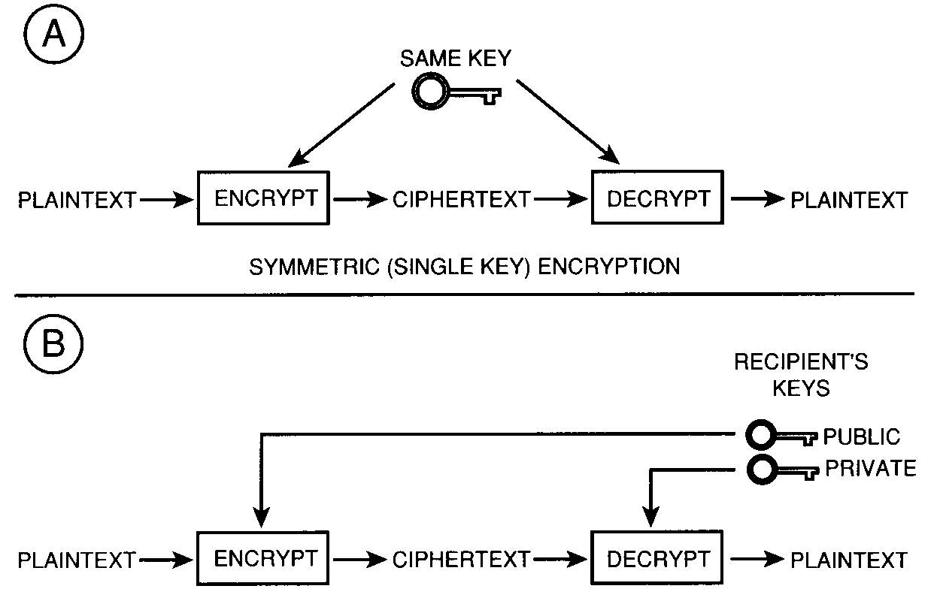
Comparison of SE and AE

Slide 18
https://www.youtube.com/watch?v=6-JjHa-qLPk&t=155s https://www.youtube.com/watch?v=r4HQ8Bp-pfw

Slide 19
https://www.youtube.com/watch?v=AQDCe585Lnc

Slide 20
Cryptography vs Steganography
What is steganography?
Steganography simply takes one piece of information and hides it within another. Computer files (images, sounds recordings, even disks) contain unused or insignificant areas of data. Steganography takes advantage of these areas, replacing them with information (encrypted mail, for instance). The files can then be exchanged without anyone knowing what really lies inside of them. An image of the space shuttle landing might contain a private letter to a friend. A recording of a short sentence might contain your company's plans for a secret new product. Steganography can also be used to place a hidden "trademark" in images, music, and software, a technique referred to as watermarking.

Slide 21
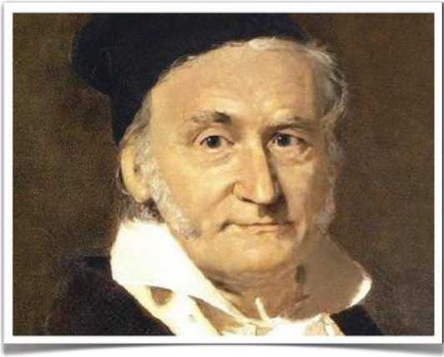
Examples
Cryptography
Steganography
H6R MUt DC C |  | 1>4t» | - JTL£ | - 2TL | 224 - | HUV XNQ | •
DKftKI | CUZAF | MHSDC | AW XV J | CVZMH | DKQZ* | HVRJC | KAJV3
ELM I fc | XDUUF | ECEGN | OUXNQ | CIIZX | Firyi | STKWI | GOEOC
crnruc | KTTYb | ZHDTJ | WCMWh | OXOFX | ERVQfc | JUCVY | P9ACQ
EfMXE | M>QKF | l VRW» | uuxz | FFTVR | CiCWYC | WJUiA | OJLKVC
 | t'VUU) | WFZJZ | ktliVQC, | YFC«1Q | RNVWF | QQ1DQ | QVVtW
LJLBU | LhHJl | onwr | JJVUA | ttfFi
CCT 2/) RtWN 1852 FLC
Message encrypted using the Enigma during WW2
Message of 500 bytes hidden within image

Slide 22
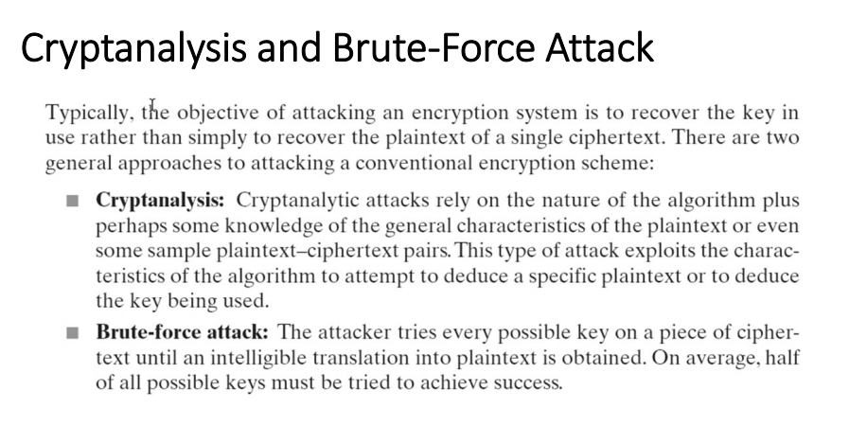

Slide 23
Things to remember
Cryptography is:
• A tremendous tool
• The basis for many security mechanisms
Cryptography is not:
• The solution to all security problems
• Software bugs
• Social engineering attacks

Slide 24
https://www.youtube.com/watch?v=Zbqo7MGVElw&t=9s

Slide 25
Classical Cryptographic Techniques
We have two basic components of classical ciphers: substitution and transposition
Substitution: In substitution ciphers letters are replaced by other letters
Transposition: In transposition ciphers the letters are arranged in a different order

Slide 26
Monoalphabetic and Polyalphabetic Ciphers
Monoalphabetic - only one substitution/ transposition is used
Polyalphabetic - where several substitutions/ transpositions are used
Several such ciphers may be linked together to form a Product Cipher

Slide 27
Caesar Cipher - A Monoalphabetic Substitution Cipher
Replace each letter of message by a letter a fixed distance away e.g. use the 3rd letter on
Reputedly used by Julius Caesar, e.g.
L FDPH L VDZ L FRQTXHUHG
I CAME I SAW I CONQUERED
i.e. mapping is
ABCDEFGHIJKLMNOPQRSTUVWXYZ
DEFGHIJKLMNOPQRSTUVWXYZABC

Slide 28
https://www.youtube.com/watch?v=sMOZf4GN3oc

Slide 29
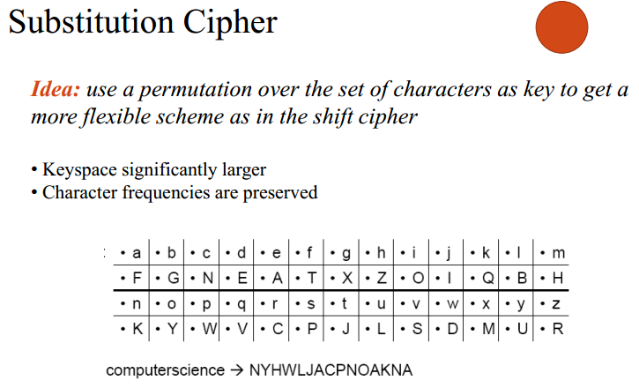

Slide 30
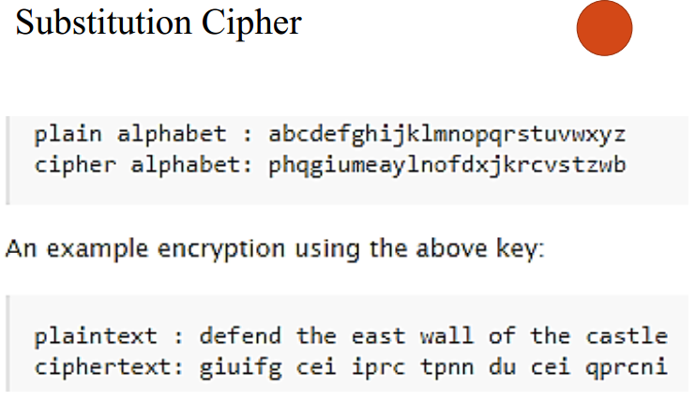

Slide 31
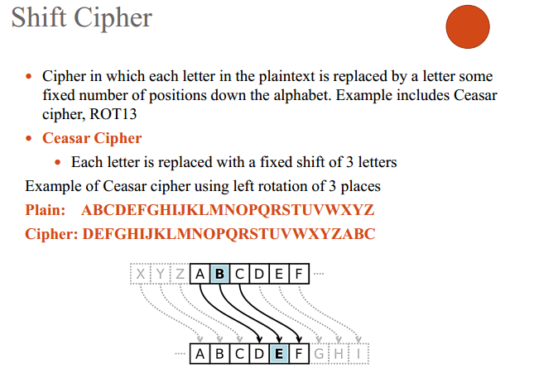

Slide 32
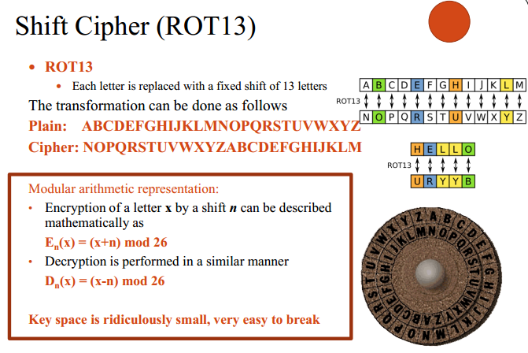

Slide 33
Frequency-based Cryptanalytic Attacks
Cryptanalyst knows the letter-frequency distribution of the language
Cryptanalyst constructs the letter frequency table of the cipher-text
Cryptanalyst tries to find letter pairs with the same frequency distribution in the plain text and cipher text
Also uses the frequencies of di-grams and tri-grams

Slide 34
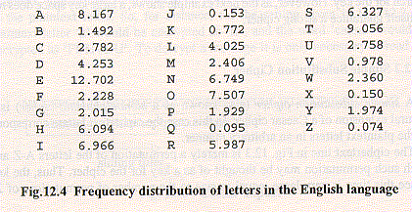
Frequency Distribution of Letters

Slide 35
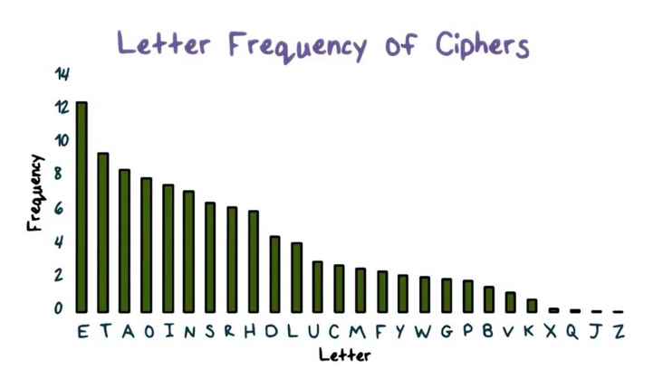

Slide 36
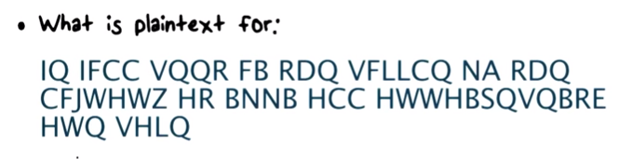

Slide 37
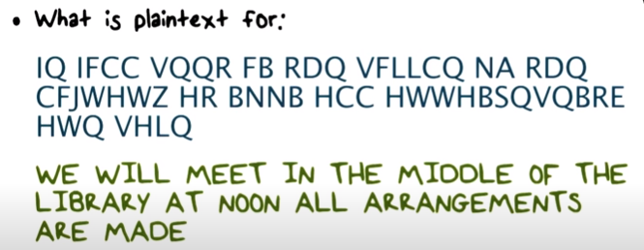

Slide 38
Polyalphabetic Substitution Cipher
Polyalphabetic Substitution - several substitutions are used.
Used to hide the statistics of the plain-text.

Slide 39
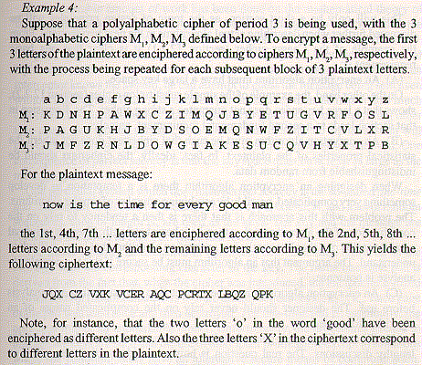
Polyalphabetic
Substituion Example

Slide 40
Transposition Ciphers
Transposition or permutation ciphers hide the message contents by rearranging the order of the letters
Scytale Cipher is an example of a transposition cipher

Slide 41
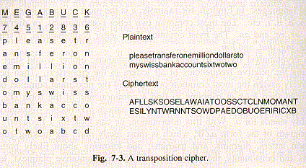
Transposition Cipher Example

Slide 42
Playfair Cipher
The best-known multiple-letter encryption cipher is the Playfair, which treats digrams in the plaintext as single units and translates these units into ciphertext digrams. The Playfair algorithm is based on the use of a 5 * 5 matrix of letters constructed using a keyword.
Playfair cipher was for a long time considered unbreakable. It was used as the standard field system by the British Army in World War I and still enjoyed considerable use by the U.S. Army and other Allied forces during World War II.

Slide 43
Hill Ciphers
Another interesting multiletter cipher is the Hill cipher, developed by the mathematician Lester Hill in 1929.

Slide 44
One Time Pad
A one-time pad is a very simple yet completely unbreakable symmetric cipher.
A one-time pad involves sheets of paper with random numbers on them: These numbers are used to transform the message; each number or sequence of numbers is used only once.
The recipient of the message has an identical pad to use to decrypt the message. One-time pads have been proven to be foolproof-without having a copy of the pad.

Slide 45
What is a One-Time Pad?
With a one-time pad, there are as many bits in the key as in the plaintext. This is the primary drawback of a one-time pad, but it is also the source of its perfect security.
It is essential that no portion of the key ever be reused for another encryption (hence the name "one-time pad"), otherwise cryptanalysis can break the cipher.

Slide 46
Why are One-Time Pads Perfectly Secure?
An attacker can't compute the plaintext from the ciphertext without knowledge of the key, even via a brute force search of the space of all keys!
Trying all possible keys doesn't help you at all, because all possible plaintexts are equally likely decryptions of the ciphertext.

Slide 47
https://www.youtube.com/watch?v=FlIG3TvQCBQ

Slide 48
Example Symmetric Encryption Algorithm - DES
The most well known symmetric system is the Data Encryption Standard (DES).
Data Encrypt Standard (DES) is a private key system adopted by the U.S. government as a standard “very secure” method of encryption.

Slide 49
Private Key Problems
Keys must be exchanged before transmission with any recipient or potential recipient of your message. So, to exchange keys you need a secure method of transmission, but essentially what you've done is create a need for another secure method of transmission
Secondly the parties are not protected against each other, if one of the parties leaks the keys it could easily blame the other party for the compromise

Slide 50
Public Key Encryption
To overcome the drawbacks of private key systems, a number of mathematicians have invented public key systems.
Public key means that anyone can publish his or her method of encryption, publish a key for his or her messages, and only the recipient can read the messages. This works because of what is known in math as a trapdoor problem.

Slide 51
Trapdoor problem
A trapdoor is a mathematical formula that is easy to work forward but very hard to work backward. In general it is easy to multiply two very large numbers together, but it is very difficult to take a very large number and find its two prime factors.

Slide 52
RSA
The best known public key system is RSA, named after its authors, Rivest, Shamir and Adelman.

Slide 53
Uses of Encryption
Protecting data from prying eyes is not the only security issue in networking. One can imagine at least four security services:
Protecting data from being read by unauthorized persons
Verifying the sender of each message (authentication)
Preventing unauthorized persons from inserting or deleting messages
Making it possible for users to send signed documents electronically
Encryption can be used to achieve all these goals.

